Slide 1

Demo presentation
Matyas molnar
Week 7
Github : green-fox-academy/matyoo111

Slide 2
Content of presentation
Introduction
Fox Club project first steps and problems
Fox Club project improvements
Conclusion

Slide 3

Hiking

Slide 4
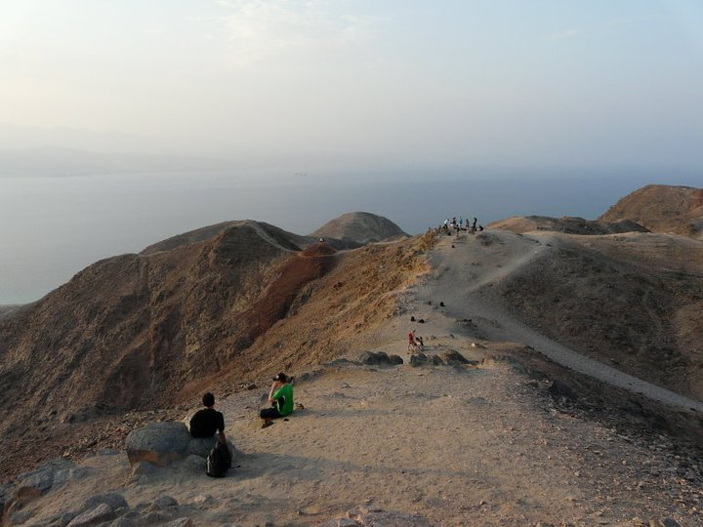

Slide 5
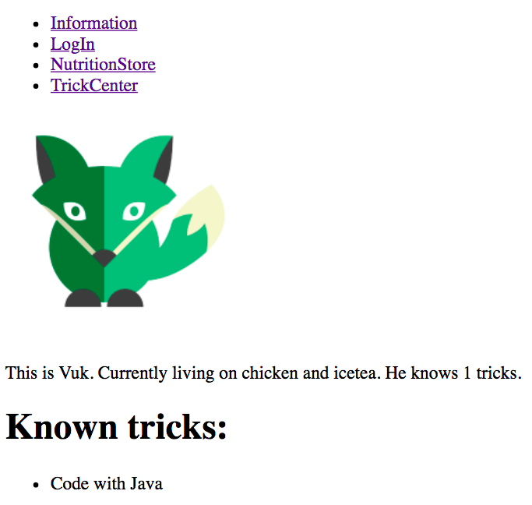
Fox club
Index page for information and links
LogIn page for registering/login NutritionStore for setting food and drink
TrickCenter for learning tricks

Slide 6
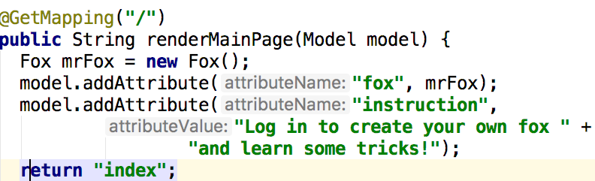
Fox club
GetMapping for showing pages
PostMapping for information input
Tried to think about each possible outcome (such as if there is no fox registered in the database)

Slide 7
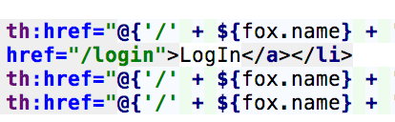
@Pathvariable + Links with foxnames

Slide 8
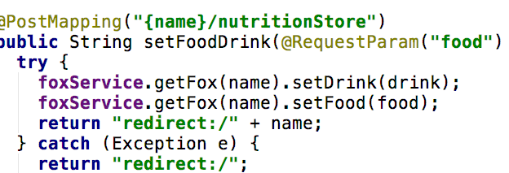
Error handling for @PostMapping: pay attention to redirect the user to the index page even if no name is found for identification

Slide 9
Problem: did not save registered foxes
When I logged in with another fox, the previously added foxes disappeared
Solution: restructuring some functions
Create interface and class for repository and services
Thus a map of foxes were not redefined when using some functions in the @Controller

Slide 10
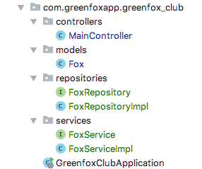
New structure
Repositories for basic saving and fox identification
Services for implementing repository functions
Solved problem, foxes were saved

Slide 11
Thank you for watching!
Matyas molnar
Github : green-fox-academy/matyoo111
Linkedin : https://www.linkedin.com/in/molnarmatyas/

